Slide 1
About Genetic Counseling
Presenter Name
Presenter Title/Credentials (e.g. Certified Genetic Counselor)
Presenter Pronouns

Slide 2
Fun Facts
How much DNA do you share with…
Best Friend?
Banana?
E. coli?
99.9%
40%
7%

Slide 3
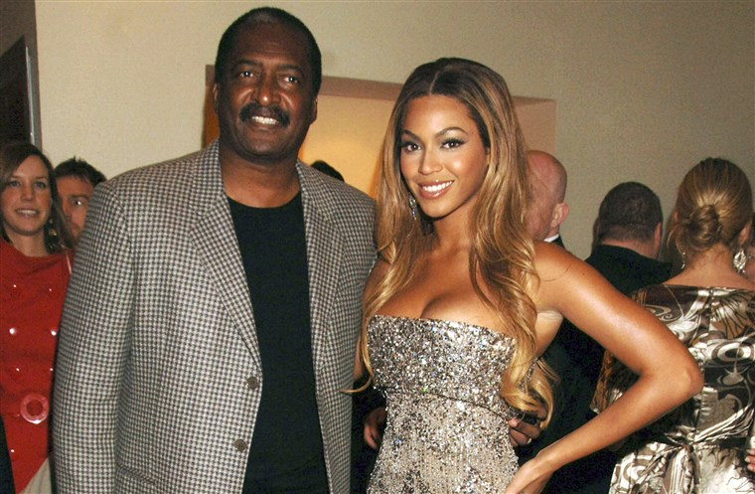
Genetics in the Media
“The Angelina Jolie Effect”
Hereditary Breast and Ovarian Cancer Syndrome (BRCA1/BRCA2)
Matthew Knowles
Beyonce’s father, BRCA2 mutation carrier, and male breast cancer survivor

Slide 4
Genetics & You
At your next family gathering, think about drawing your family tree!
You!

Slide 5
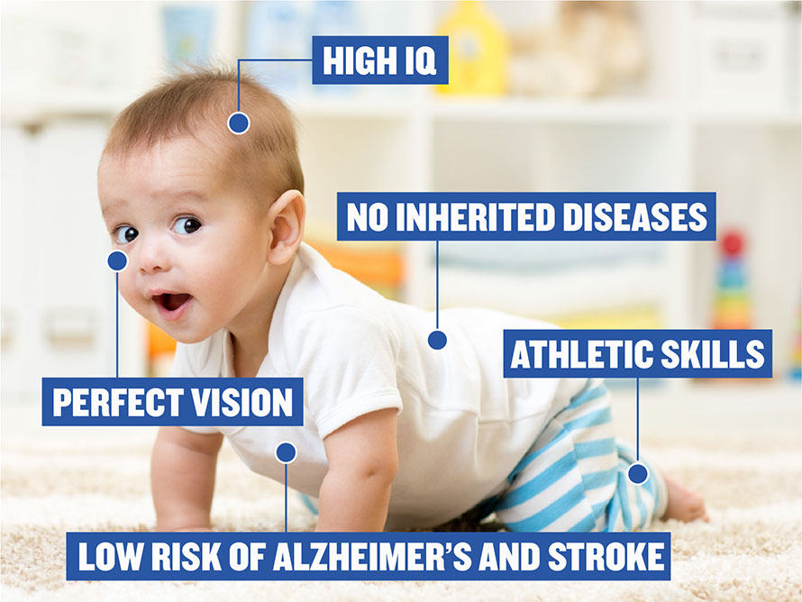
What a Genetic Counselor Doesn’t Do
Help expecting parents create designer babies
Clone people

Slide 6
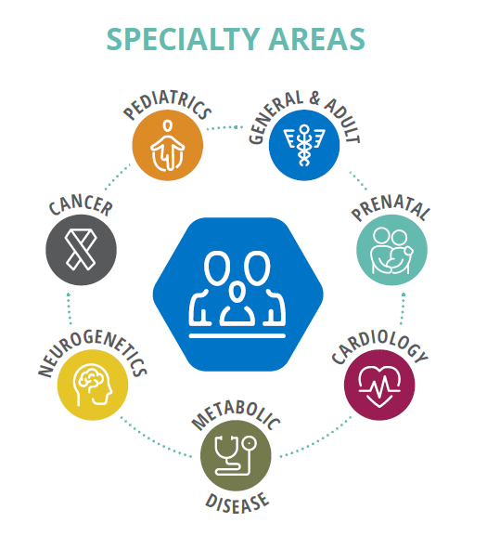
What Does a Genetic Counselor Do?
Provide information about genetics, inheritance, and specific genetic conditions
Discuss the benefits, risks, and limitations of genetic testing
Interpret genetic testing results and help patients make decisions using those results and other important information
Provide support to patients, their families, their other healthcare providers, and their community

Slide 7
On Any Given Day, A Genetic Counselor is a...
Scientist
Counselor
Detective
Translator
Teacher
Advocate

Slide 8
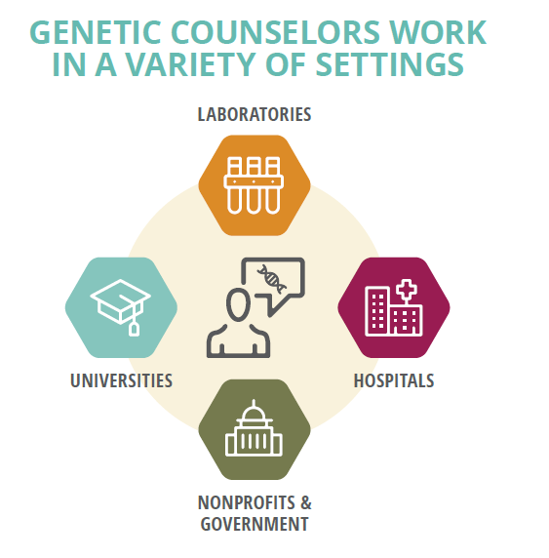
Where Do Genetic Counselors Work?
Notes:
Where do GC’s work?
Clinics, hospitals, or universities
Genetic testing laboratories
Private companies (counseling, biotech, pharma)
Public health settings
Research settings
Health insurance companies

Slide 9
Why Become a Genetic Counselor?
Love science
Interested in healthcare
Like helping people (directly or indirectly)
Good work/life balance
Job security
Genetic counseling has been ranked as a Top 10 Best Healthcare Support Job and one of the Top 40 Best Jobs by the U.S. News & World Report
~90% job satisfaction
$78,000 average starting salary
$102,000 average salary in 2021
Notes:
If you love science or are interested in working in healthcare and like helping people - whether directly or indirectly - genetic counseling might be for you!
Most positions have a good work/life balance, with approximately 90% of genetic counselors reporting that they are satisfied with their job in a professional status survey. For comparison, approximately 70-80% of doctors report being satisfied with their jobs.
The profession has grown significantly since ~2000, with >100% growth in just the last 10 years. Job growth has been significant leading to good job security within the profession.
Given the growing importance of genetics in various medical subspecialities, compensation within the profession has become more competitive, with an average starting salary of ~$78,000 for new graduates and an average salary of ~$102,000 per data from the 2022 professional status survey.
Given this, it’s no surprise that genetic counseling often tops “Best Jobs” lists!
Approximately three-quarters of 2021 graduates (71%) accepted their first genetic counseling position before graduation.

Slide 10
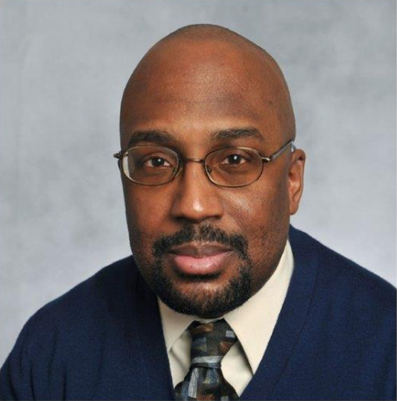
Why Become a Genetic Counselor?
If you love genetics and counseling, this is the field for you. The opportunities are endless.
Patrick L. Wilson, MS, CGC
I love the way genetic counseling empowers people to make decisions about using genetic technologies to help improve their health, and that we guide them through this process through education and respect for their values and beliefs.
Monica Alvarado, MS, LCGC

Slide 11
Why Become a Genetic Counselor?
I decided to become a genetic counselor because many Black women, including myself, have felt invisible to and unheard by the medical community.
As healthcare providers with training in genetics and psychosocial skills, the direct contact we have with patients enables us to build rapport and give a voice to the voiceless. This is one of the reasons why I want to be a genetic counselor, to not only help my community but all marginalized communities across the country.
Quinlyn Highsmith, BS
Genetic Counseling Student
Notes:
“I decided to become a genetic counselor because many Black women, including myself, have felt invisible to and unheard by the medical community. As healthcare providers with training in genetics and psychosocial skills, the direct contact we have with patients enables us to build rapport and give a voice to the voiceless. This is one of the reasons why I want to be a genetic counselor, to not only help my community but all marginalized communities across the country.”

Slide 12
How Do You Become a Genetic Counselor?
STEP ONE
STEP TWO
STEP THREE
Undergraduate/ Bachelor’s Degree
Typically in:
Biology or other classic science
Social science
Other relevant experience:
Volunteer work
Research & lab work
GC shadowing
Master’s Degree
During a 2 year program, you’ll complete:
Coursework
Clinical training & rotations
A research project
>50 GC programs across the U.S. and Canada
Certification & Licensure
After graduation, you’ll take a board examination.
Then, depending on which state(s) you will practice in, you may need to apply for state licensure.

Slide 13
Graduate Program Application Process
September
Applications Open
February - April
Interviews
December - February
Application Deadlines
Late-April
Match Day!

Slide 14
Graduate Program Application Requirements*
Personal Statement
Letters of Recommendation
Transcripts
Genetics
Biochemistry
Statistics
Psychology
GRE scores
Curriculum Vitae/Resume
Advocacy Experience
Training in interpersonal and communication skills
Work with the public one-on-one
Exposure to the field
Shadowing
Informational Interviews
Summer Internships/Workshops
Genetic Counseling Assistantship
*Requirements vary by program

Slide 15
My Journey to Genetic Counseling
Personalized by presenter to describe their interest in/journey to the field + current role, etc.

Slide 16
Who Are Genetic Counselors?
NSGC 2022 Professional Status Survey
93% Female
89% White/European
Studies show that racial/ethnic concordance between healthcare providers and patients leads to better patient outcomes¹
Diversity of all kinds is sorely needed!
1. E.g. Greenwood, B.N. et al. “Physician-patient racial concordance and disparities in birthing mortality for newborns.” Proc Natl Acad Sci USA. 2020;117(35):21194-21200.

Slide 17
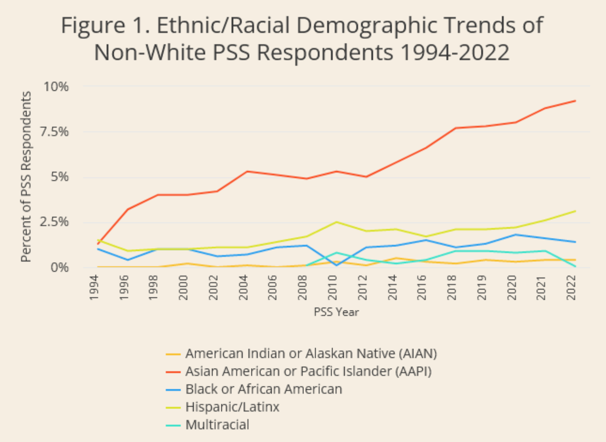
Ethnic/Racial Trends in the Profession
NSGC Professional Status Survey data shows a slow trend of increasing diversity within the profession over the last ~30 years, with variation between groups.

Slide 18
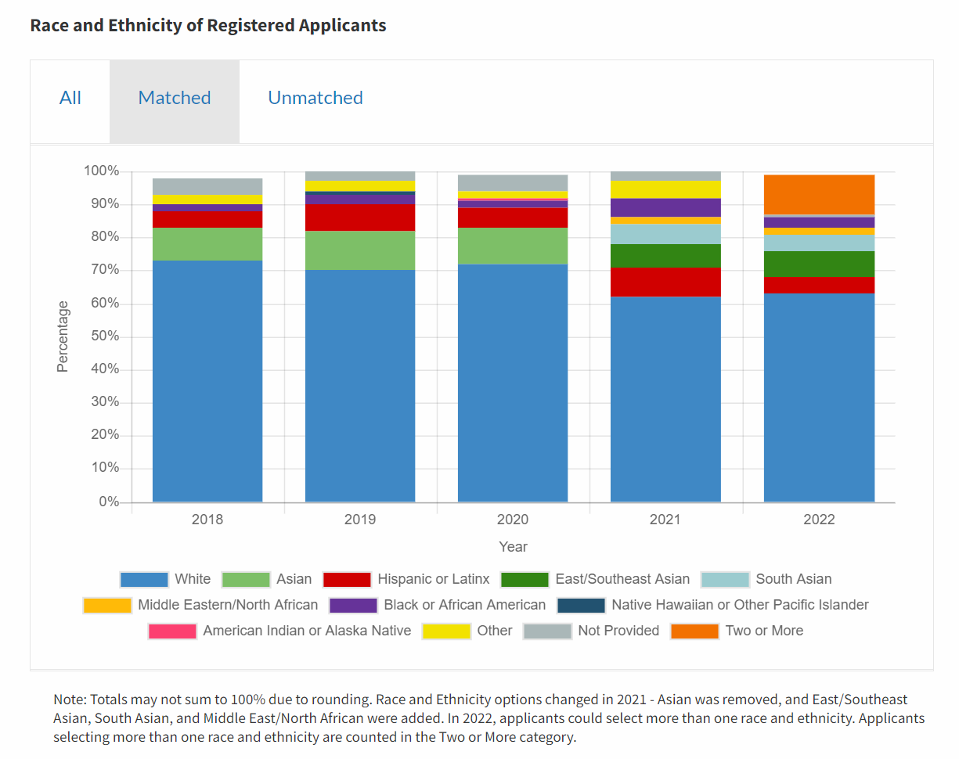
2022 GC Match Data
Genetic counseling applicant match data shows a more consistent trend of increasing diversity in recent years.
Notes:
https://natmatch.com/gcadmissions/statistics.html

Slide 19
Networks Dedicated to Diversity and Equity
The Minority Genetic Professional Network increases minorities access to genetic services by increasing the ethnic diversity of genetic providers.
The GC Trainee Platform for Racial Justice (GCRJ) fosters a community of genetic counseling trainees that is grounded in becoming actively anti- racist.
GOLDEN seeks to inform Black students about the career of genetic counseling and support prospective Black genetic counselors.
A community of genetic professionals driven to expand awareness and access to genetic counseling services and improve the quality of life of Latin Americans
Notes:
https://mgpn.chronus.com/
https://sites.google.com/view/gcrj/home?authuser=0

Slide 20
Scholarship Programs
Alliance to Increase Diversity in Genetic Counseling (AID-GC)
Partnership between WAF and UPenn to increase # of GCs from underrepresented backgrounds
Participating GC programs: UPenn, Boston Univ., Rutgers, State Univ. of NJ, Sarah Lawrence College, and Univ. of Maryland
Provides a full tuition scholarship and a stipend to cover living expenses

Slide 21
Scholarship Programs
Basser Center Scholarship
Funded by the Advisory Board of Penn Medicine’s Basser Center for BRCA
Designated for Black and Latinx individuals pursuing GC at UPenn
Provides a full tuition scholarship
Notes:
GC programs with diversity scholarship tracks that can be chosen during match rankings
University of South Carolina
Need to find out other programs with diversity scholarships

Slide 22
Summer Internship Opportunities
The Basser Center for BRCA at the Abramson Cancer Center, University of Pennsylvania, has established an eight-week paid ($5000) summer internship program in genetics for four underrepresented minority students.
Six-week summer internship designed to promote understanding of the genetic counseling profession, excellent preparation for graduate education in genetic counseling.
Full-time, six-week-long, paid ($3600) summer internships at Penn Medicine and the Children's Hospital of Philadelphia. Designed for undergraduate students from diverse populations who are interested in careers in genetic counseling. The internship provides exposure to a broad range of clinical genetics specialties, conferences.
Notes:
https://www.basser.org/sites/default/files/documents/2021-12/2022-Basser-Center-URM-summer-internship.pdf
https://sc.edu/study/colleges_schools/medicine/education/graduate_programs/genetic_counseling/preparing_for_graduate_school/summer_internship/index.php

Slide 23
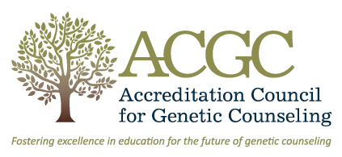
Learn More
About Genetic Counselors, brought to you by the National Society of Genetic Counselors (NSGC) www.aboutgeneticcounselors.org
Accreditation Council for Genetic Counseling (ACGC)
www.gceducation.org
Genetic Counseling Experience Initiative (GCEI)
twitter.com/gcexpinitiative

