Slide 1
Genetic Patient Navigation: Maximizing Risk Identification and Compliance in Diverse Populations
Sara Pirzadeh-Miller, MS, CGC
Assistant Director, Cancer Genetics
UT Southwestern Medical Center

Slide 2
COI
CancerGene Connect: original inventor
Advisor, Genetic Counselor Advisory Board, Invitae
Board Member/Advisor, GeneMatters, Inc.

Slide 3
Objectives
Describe components of a genetic navigation program for population screening and mutation positive patients.
Apply principles of genetic patient navigation through institutional case examples.
Notes:
Objective 1: *Describe construction of genetic navigation program in mammography/GI clinic populations at UT Southwestern and Parkland Health System.
*Discuss genetic patient navigation program initiation for mutation positive patients.
*
Objective 2: *Illustrate patient cases flagged in mammography and GI clinics with resulting strategies to facilitate high-risk patient care.
*Highlight mutation positive patients navigated through underserved hospital system with barriers to care and navigator assistance.
*Use cases to summarize toolkit construction with program resources and experience. This toolkit will be a resource to programs in attendance to apply in their own settings.

Slide 4
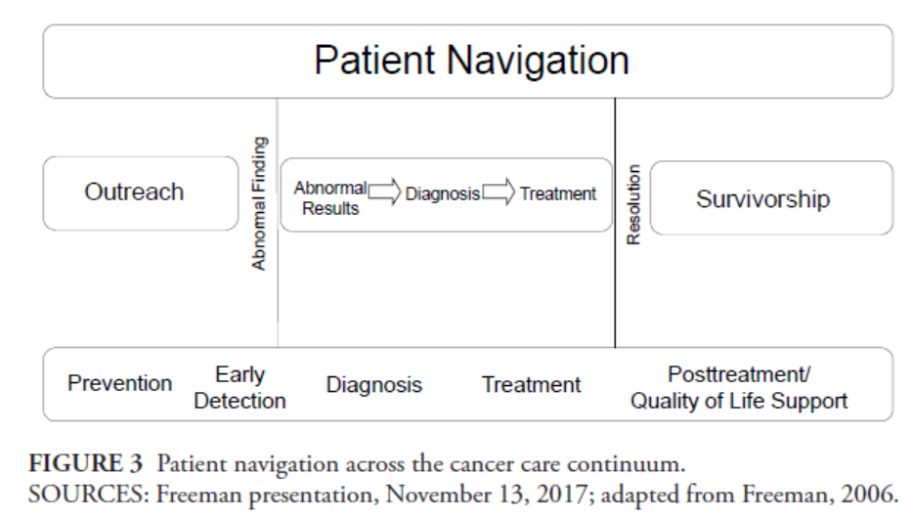
Notes:
Evidence base:
Paskett also reported that her review of 29 studies on patient navigation conducted between 2010 and 2015 (mostly for patients with breast cancer, but also patients with cervical, colorectal, and lung cancer) found that the majority showed patient navigation to be effective in increasing screening rates and reducing time to diagnosis and treatment, as well as improving care plan adherence, quality of life, patient knowledge, and communication with clinicians (Krok-Schoen et al., 2016).
one randomized, controlled clinical trial found that patient navigation increased rates of colorectal cancer screening compared with usual care in a vulnerable population (Reuland et al., 2017), and an observational study found that patient navigation reduced costs, emergency room visits, hospitalizations, and intensive care unit admissions compared with controls in a Medicare population (Rocque et al., 2017).
This resulted in an estimated savings of $19 million in health care costs,

Slide 5
Notes:
The Advisory Board. Blueprint for Growth Part III: Perfecting Pt Navigation & MD Care. 2008

Slide 6
Barriers to Care
Level of Influence | Category | Barrier | Questions to Ask
Intrapersonal | Finance | Insurance | Does pt have insurance? Is paying for health care a concern? Is pt able to pay for all needed meds at 1 time? Are there other financial needs (food, housing) that delay health care?
 |  | Housing | Is housing a concern at this time?
 | Transportation | Lack of transportation | Can pt get from home to site of health care? Is pt aware of any transportation assistance? Is pt traveling out of the area during the HC treatment time? Is the distance to the HC facility a concern?
 | Comorbidities | Disability | Does pt have a mental or medical disability? Is so, what is the current care & provider?
 |  | Comorbidities | Does pt have 1 or more medical comorbidities? If so, what is the current care & provider?
 | Attitudes, beliefs, perceptions | Fear | Does pt have fear of tests or Rx? Has pt had an unpleasant experience w/ health care or provider? Are there cultural beliefs the HC team needs to be aware of? What is pt’s perception about receiving HC?
Mahon, et al., Guide to Breast Care for Oncology Nurses. 2018.
Mahon, et al., Guide to Breast Care for Oncology Nurses. 2018.

Slide 7
Barriers to Care (cont’d)
Level of Influence | Category | Barrier | Questions to Ask
Intrapersonal | Family, employment, communication | Family | Does pt have a social support system through family or friends? Who is the primary caregiver? Is the caregiver local? Is there child care available? Are family/ friends available to provide assistance during HC? Is there a need for other family care during Rx?
 |  | Employment | Are there work issues that will make HC difficult?
 | Communication | Literacy | Can the pt understand oral & written information from the HC team? Is there a lack of understanding after HC info is given to the pt?
 |  | Language | Is an interpreter needed for the pt?
Institutional | Healthcare System | Logistics | Are HC facilities too far for the pt to travel? Are the hours of operation inconvenient?
 |  | Delays | Are there problems with scheduling care? Are there too long phone delays, either waiting on the phone or waiting for a call? Is there a concern with office wait time? Is there confusion over rescheduled medical appointments?
 | Unknown |  | Do any other cited barriers to care exist?
Mahon, et al., Guide to Breast Care for Oncology Nurses. 2018.
Mahon, et al., Guide to Breast Care for Oncology Nurses. 2018.

Slide 8
Use of Genetic Patient Navigators to Help Mutation Carriers Comply with NCCN Guidelines and to Enable Healthy Behaviors (PP160110)
Goals:
Increase NCCN screening guidelines compliance of underserved HBOC & LS patients
Influence lifestyle behaviors for cancer risk reduction targeting breast & colon cancer HBOC/ LS.
Promote identification of at-risk relatives of HBOC & LS probands to increase awareness of cancer risk in affected families
Expand awareness of HBOC/ LS hereditary cancer pt identification & mgmt. guidelines in targeted populations.
Notes:
1. NCCN Guidelines: ↑ compliance underserved (39%)to insurance pop (72%); ↑ underserved HBOC uptake in RRBSO/ ovarian ca reduction; sustain or ↑ # insured HBOC screening guidelines/ rrBSO compared to baseline. ↑ underserved compliance screening (81%) to ins’d comp (90%); sustain or ↑ insured LS screening comp.
2. Tobacco use effects/ CRC; MCI pre-vivorship program in FW as well as 10 counties in north TX.
3. Cascade testing
4. Professional education

Slide 9
GPN Contact of HBOC/LS probands
Ascertain follow-up information regarding cancer risk reduction
Evaluate lifestyle factors/ social support barriers
Educate patients for specific cancer risks and facilitate referrals
Provide lifestyle factor counseling
Made referrals to previvorship programs
Recorded identified at-risk relatives per proband and provided education to promote testing
Increase Cascade Testing
Identify Patient Resources
Increase NCCN Compliance
Notes:
Contact of HBOC/ LS probands by Genetic Patient Navigator (GPN)
Ascertain follow-up information regarding cancer risk reduction
Evaluate lifestyle factors/ social support barriers
Educate patients for specific cancer risks and facilitate referrals
Provide lifestyle factor counseling
Made referrals to previvorship programs
Recorded identified at-risk relatives per proband and provided education to promote testing

Slide 10
Navigation scenarios…
62 yo county hospital patient with personal hx colon cancer & Lynch syndrome.
Pt asked for financial assistance resources for household expenses.
GPN tracked down social worker at location where pt was to be seen.
Informed how to request social worker meeting at time of office visit that same day as my call. Pt was to let me know if unable to hook up with SW.
29 yo county hospital patient, unaffected BRCA1+ pt, previously uninsured who now has insurance.
Working with her to find in-network providers to get her in for screening/ surveillance appointments.
Notes:
EB, 52 yo unaffected LS pt.
Helped get her hooked up with ColonoscopyAssist program through which she underwent a screening EGD 11/21/2017. I had previously helped her coordinate a screening colonoscopy as part of an annual colon cancer awareness month initiative. Coordinated getting her in with her JPS PCP (Jan-March 2018) when she was reporting symptoms of unexplained weight loss and chest pain.
Pt is now having symptoms of lower back pain, unexplained weight loss, & muscle mass loss. Initially unsuccessful getting into JPS Connections, I am trying to get her back in to see them as suggested by Jackie since it has been more than 6 months since she was turned down for the program. Also working on getting her back in for another screening colonoscopy as she is currently uninsured & without funding. Have been in touch with her PCP, Dr. Koch, at JPS regarding her symptoms.
She has 3 additional family members who have not yet undergone genetic testing. I have told her on more than one occasion about the DUAL program. She says her she has mentioned it more than once to her family members, however they are just not interested in undergoing testing at this time.

Slide 11
HBOC and LS Patient Compliance with GPN Impact
Notes:
Breast Underserved: 39% to 83% compliance. Breast Insured: 72% to 76% compliance.
rrBSO Underserved: 40% to 79% compliance. rrBSO Insured: 71% to 77% compliance.
Colonoscopy Underserved: 81% to 82% compliance. Colonoscopy Insured: 90% to 86% compliance.

Slide 12
GPN Data over 24 months (PP160110)
62 public education services, 578 people educated
436 navigated to 431 services across 24 counties
Survivorship scheduled/received by 51 people
92 improved health behaviors and 64 received physician referral
2357 professionals educated via 16 professional outreach events in 25 counties
Cascade from 1 to 2.7
Notes:
In 24 months, the GPN completed 62 public education services, with 578 people educated. 436 people were navigated to 431 services across 24 counties. Survivorship services were scheduled/ received by 51 people. 92 people improved their health behaviors and 64 received a physician referral. A total of 2,357 professionals were educated via 16 professional outreach events in 25 counties. The cascade testing ratio for family members improved from 1.0 to 2.3.
32% of our patient population is uninsured/ underserved. Our program implemented a genetic patient navigator (GPN) to provide assistance to increase patient compliance and healthy lifestyle promotion with focus on underserved population. We describe here the utilization of a GPN on surveillance compliance and lifestyle practices among underserved/uninsured and insured HBOC and LS mutation carriers within the UTSW clinics. We also provided professional education services to improve genetic health literacy among non-genetic HCPs.

Slide 13
Cascade Testing
GPN Impact
Follow-up
Reducing barriers
Providing additional resources
2 : 1
Genetic Counseling
Family Letters
2.7 : 1
Genetic Counseling
Family Letters
GPN

Slide 14
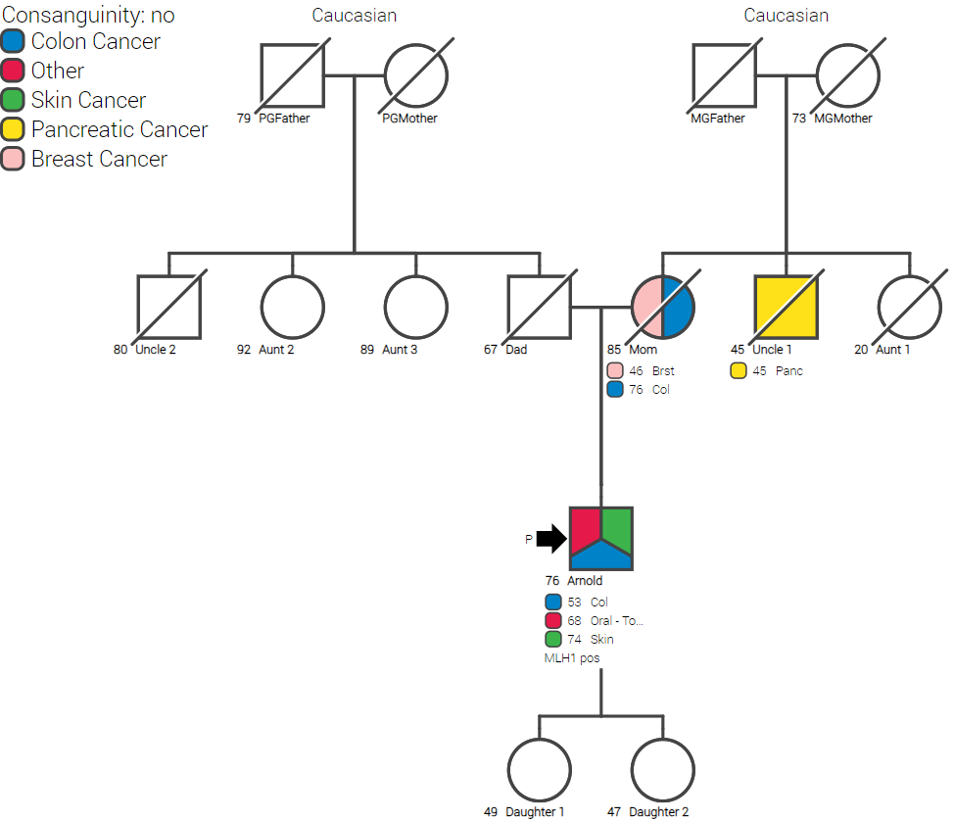
Notes:
Arnold Paul. I was at an oncology nursing program last night, and sat next to a nurse who I’ve gotten to know through Dallas ONS this past year. Several months ago when I first met her, we got to talking about family history (I think we were talking about our roles were within the SCC, and she brought up her family history). Based on her father’s personal and family history of cancer, I strongly encouraged her to get him into genetic counseling/ testing.
Turns out he has Lynch syndrome (I’m not sure which counselor saw him-- Remington?). My nurse friend had cascade testing and was negative (Remington). Her sister, however, underwent cascade testing and was found to have LS (I think Elise tested her). On prophylactic hysterectomy, she was found to have Stage II endometrial cancer, previously undetected.
A hopefully good ending to a potentially bad outcome ☺. Yeah cascade testing! Not sure if they are/ were a DUAL family…

Slide 15
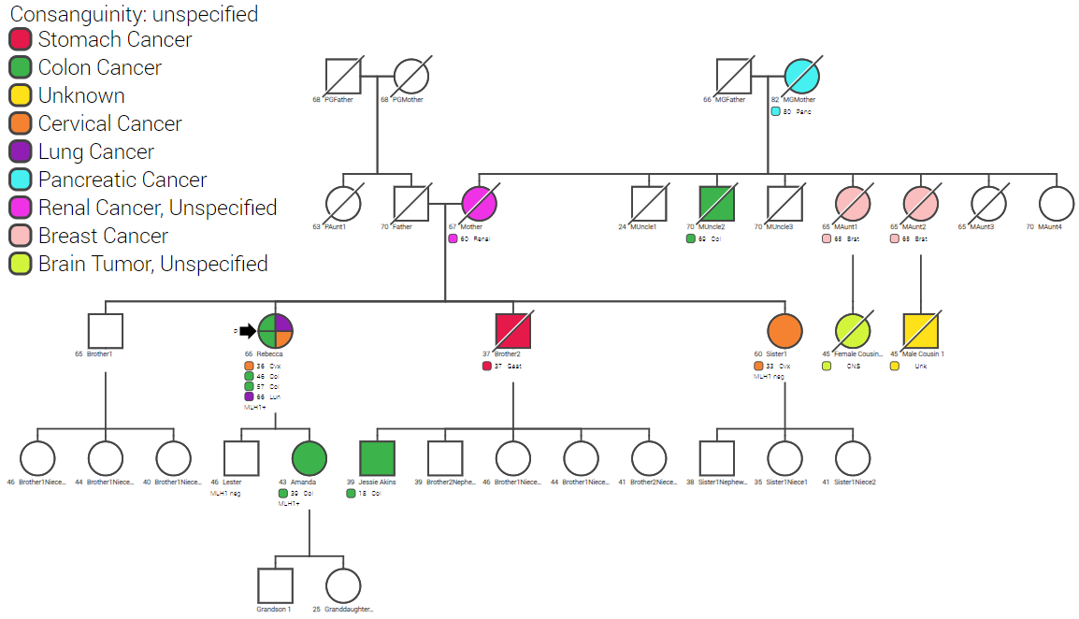
Notes:
I spoke to a lady today who underwent testing with Arielle back 2013. Pt had had cervical cancer & 2 colon cancers when she was referred for GC. Testing came back with MLH1 mutation.
Pt “nagged & nagged” her children/ family. Daughter, 39, was tested, found to be MLH1+. She was found to have asymptomatic colon cancer on her baseline screening colonoscopy at age 39. She is alive & well at 43.
It won’t count for a CPRIT story, but if we ever need someone to talk for us, this lady can’t say enough about UTSW’s Cancer Genetics program & what it has done for her family.
MRN 91250881

Slide 16
Risk navigator: colorectal
Roles
How is this unique?
Screening mammo/GI lists for high-risk
scheduling telephone GC appointments
education in importance of keeping appointment/compliance
help filling out pre-visit questionnaire if requested
initiating necessary form signing by DocuSign
Focus on Lynch syndrome identification AND non-hereditary high risk for CRC
Compliance to screening: messaging
Notes:
Evolution from helping in screening high-risk lists, sending kits, help patients fill out CGC, create waitlist for telephone slots
Main jobs now: contacting high-risk list, scheduling telephone or in-person appointments, education in importance of keeping appointment/compliance, help filling out CGC if requested (now GCA job), initiating necessary form signing by DocuSign

Slide 17
Breast Screening
Detecting Unaffected Lynch Syndrome (PP160103) – 28 month data
94,665
5,207
Mammo pts screened via survey
5.5% screened “high-risk”
1,950
775
62
GI Screening
Referred for genetic counseling
Saw a GC & elected testing
8% tested positive
21,434
750
GI pts screened via survey
3.5% screened “high-risk”
Data is lower here as project is in-progress
Notes:
DUAL 28 month data

Slide 18
Mutation Spectrum
RECQL4
ATM
BRCA2
BRIP1
BARD1
HOXB13
NBN
PALB2
RAD51C
Non-CRC
APC
AXIN2
CHEK2
MUTYH (het)
CRC
MLH1
MSH2
MSH6
MSH6/MUTYH (het)
Lynch

Slide 19
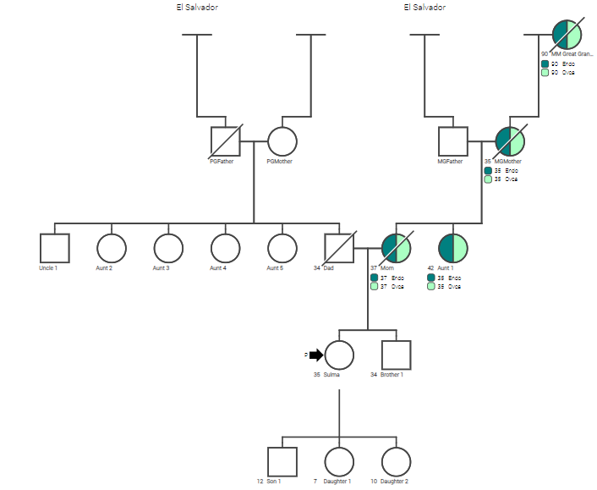
County hospital mammography screening
Result: RAD51C+
Notes:
Sulma Fuentes
Family history at Parkland, picked up in mammo family history screening and doctor
DUAL funded – RAD51C mutation
2 POLE VUS
Ovarian Cancer: NCCN 2.2017 guidelines recommend consideration of risk reducing salpingo-oophorectomy (BSO) for women with a RAD51C mutation between the ages of 45-50. Sulma has been following with Gynecology Oncolgoy at Parkland due to her personal history of abnormal uterine bleeding; both her uterus and ovaries remain intact. A copy of these results will be shared with her gynecology oncology team to further discuss the benefits, limitations, and timing of BSO given her personal, family history and RAD51C mutation.
Breast Cancer: Current guidelines suggest that there is insufficient evidence for breast cancer interventions based on a RAD51C mutation alone; an individual’s personal and family history should be considered in developing an appropriate screening plan. Sulma is recommended to pursue annual breast mammograms beginning at age 40, as recommended in the general population.

Slide 20
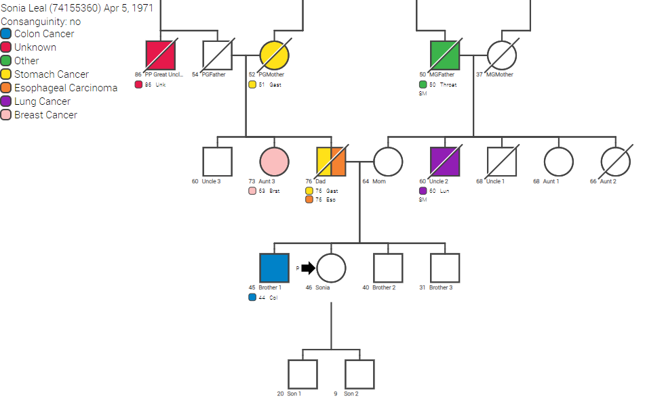
County hospital mammography screening
Result: MSH2+
Notes:
Parkland patient picked up on mammo screening
MSH2 mutation, BRIP1/MSH6 VUS
Family in Mexico

Slide 21
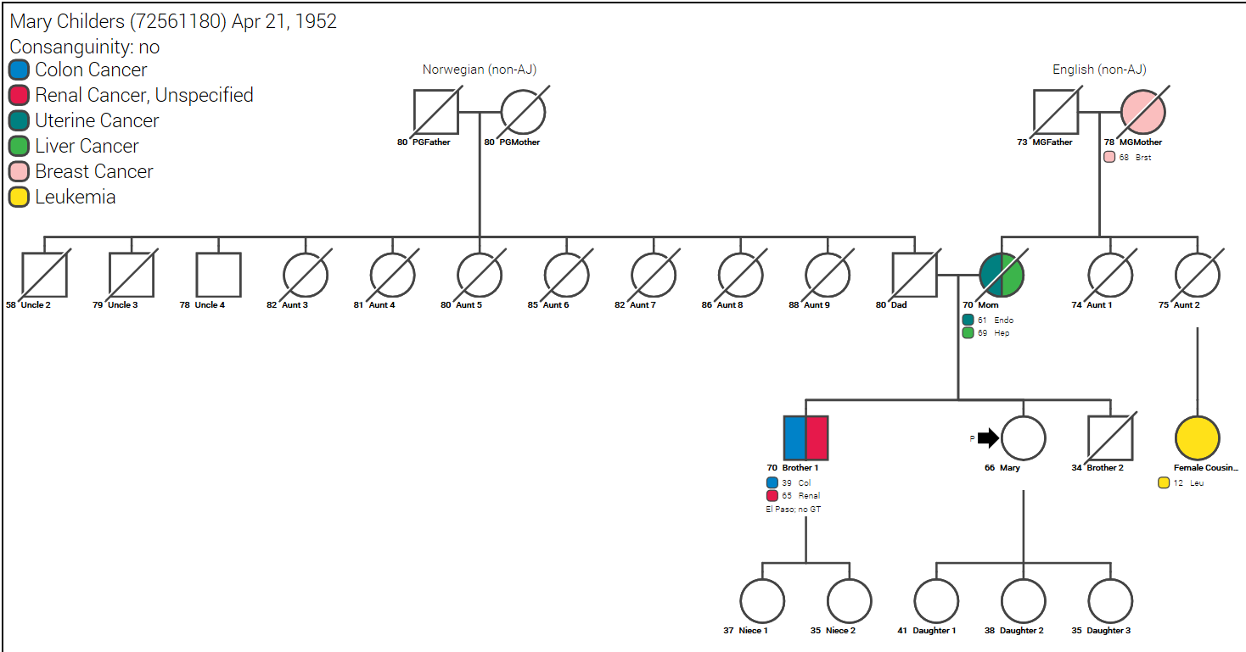
UTSW mammography screen
Hx: TAHBSO at 49, 5 colon polyps
Result: MSH6+
Notes:
MSH6 positive, UTSW mammo pickup
TAHBSO at 49 due to fibroids, 5 colon polyps

Slide 22
Risk Navigator: Breast
General Roles
Automated high-risk list with B-RST and Claus score
Contact patients to advise, educate on risk
Refer to services
What is unique in this role?
Identify HBOC risk AND lifetime breast risk
Refer to GC AND high-risk clinic
MRI downstream effect based on Claus

Slide 23
Pt has breast or GI screening
Pt completes online or paper questionnaire
Risk models calculated + FHx reviewed
Risk navigator contacts high-risk patients to place referrals
Mammography Risk Navigator
Expandable to additional settings
e.g. CancerGene
Progeny
Cancer IQ
Claus
Gail
Tyrer-Cuzick
Referral to: GC, breast team or both

Slide 24
UTSW Mammography Risk Navigator Data
16,051 Mammo pts screened
1,011 (6.3%) Screened “high-risk”
678 (67.1%) Met criteria after review
97 elected a GC referral after call
4/97 (4.1%) tested positive
Screened Apr-Dec 2018
99 pts met eligibility for high-risk breast screening referral
NCCN 2.2019 BRCA1/2

Slide 25
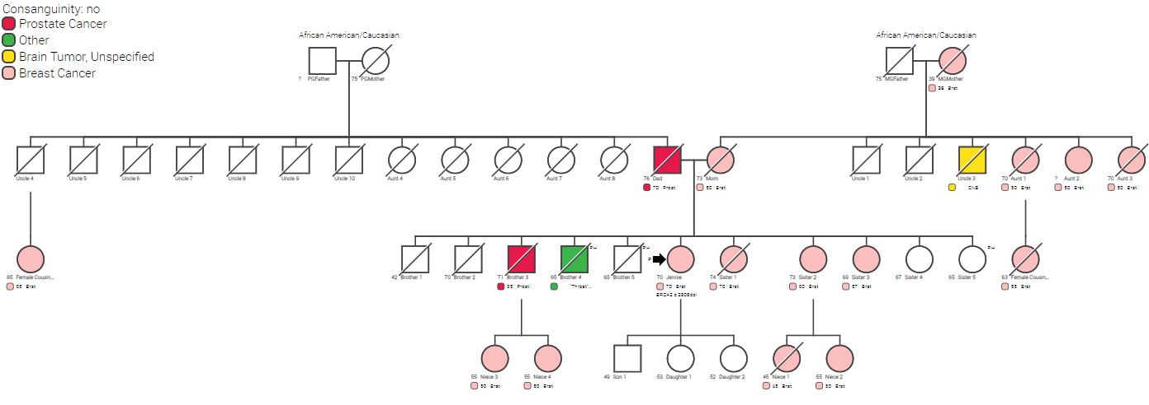
Notes:
Unfortunately this case fell through the cracks of her outside breast surgeon and was not referred with an incredibly obvious family history.
Our mammography risk navigator picked up this case based on the family history patient reported after this 70 year old patient had mammo at UTSW and was just diagnosed DCIS. She initiated appointment with our GC team who detected BRCA2 mutation. She was scheduled to undergo lumpectomy with her surgeon and changed last minute after result to bilateral mastectomy. Good work Lorraine!
Shows how focus of a navigator position in this space can increase likelihood of followup and another set of eyes on patient cases.

Slide 26
Now build the case for a position!
What will the navigator bring to the institution in this role?
Downstream impact
increasing compliance of mutation carriers
identifying unaffected with mutations
Look at the numbers!
Bringing increased consults to the institution
Notes:
What will the navigator bring to the cancer center/imaging/institution in this role?
*mammogram center – added value of screening breast risk/fhx with focus on alerting patient/provider
*cancer center – care coordination for many unrelated providers, value add like other navs.
Downstream impact of increasing compliance of mutation carriers – services/procedures/cost of treatment saved due to prevention – same argument for unaffecteds
Bringing increased consults to the institution for patients who might only be invested in screening clinics

Slide 27
Example: Initial Patient Navigation Pilot
25% time patient coordinator (i.e. GC) implemented to work on positive patient follow-up
Comparing safety-net hospital HBOC/LS patients who were contacted by coordinator versus those who were not in previous year….
Increased uptake in preventative procedures was recorded
10 of 91 contacted scheduled appointments for follow-up cancer surveillance as a result of coordinator efforts
Notes:
To establish an
internal baseline due to the
dearth of literature on this
specific topic, in 2014 we
implemented a patient
coordinator at 25% time,
Figure 1. Schematic of 22 Counties Covered.
utilizing an internal genetic counselor, to work on positive patient follow up and other grant
project management activities. Within the Parkland hospital HBOC and LS patient population,
comparing data from 2014 to 2013, an increased uptake in preventative procedures was
recorded. Furthermore, 10 patients of 91 contacted scheduled appointments for follow-up
cancer surveillance as a result of the coordinator’s efforts. This evidence of positive uptake in
NCCN cancer risk reduction recommendations due to the work of a coordinator dedicating 25%
time to the role lends itself to extrapolation of this data if full-time personnel were focusing on
these patients. Furthermore, evidence in the literature

Slide 28
Cancer Prevention Savings
827 tests * Medicare BRCA reimbursement rate ($2767) = $2,289,416
Assumptions
12 bilateral mastectomies; surgery reduces breast cancer risk by 40% = 4.8 breast cancers prevented
7 RRM; surgery reduces breast cancer risk by 50% = 3.5 breast cancers prevented
Cost of breast cancer treatment: $130,513- $236,762
18 BSO; surgery reduces ovarian cancer risk by 30% = 5.4 ovarian cancers prevented
Cost of ovarian cancer treatment: $91,524- $161,772
Cost of Cancer Treatment: $1,577,488- $2,838693
Cancer Savings: Up to $549,277
Blumen, H. 2016. Comparison of Treatment Costs for Breast Cancer, by Tumor
Stage and Type of Service. American Health Drug Benefits 2016; 9(1):23-32.
Notes:
This prevention savings also pays for more than the salary of a GPN!!!

Slide 29
Why all of the work is worth it….
Notes:
Picture of kids here

Slide 30
Conclusions
Patient navigation roles can...
Increase compliance for enhanced screening & provides the opportunity to achieve primary cancer prevention or early detection of curable cancer.
Identify high-risk patients who do not have a known genetic mutation.
Educate non-genetics providers to provide sustainable and improved identification and management of high-risk
Bring downstream services and revenue to your institutions
https://bismarck.sanfordhealth.org/cancer/patientnavigator.asp

Slide 31
Thank you! Sara.pirzadeh@utsw.edu 214-645-2563
Photo: American Airlines website
https://utswmed.org/conditions-treatments/genetics-and-hereditary-cancers/ www.cancerinthefamily.com

