Slide 1


Preimplantation Genetic Testing (PGT):
Review,
What’s new and
What you need to know
Presented by:
Sandra Darilek, MS, CGC
Assistant Professor
Department of Molecular and Human Genetics
Baylor College of Medicine

Slide 2
Disclosures
I have no disclosures.

Slide 3
Preimplantation Genetic Testing (PGT)
An option for women/couples to reduce the risk for genetic disorder in a pregnancy by:
  Using in vitro fertilization (IVF) and genetic testing or screening
  Implanting only embryos that are not expected to have the genetic abnormality of concern
Requires
  IVF
  Genetic testing of embryos

Slide 4
PGT - Terminology
A test performed to analyze the DNA from oocytes (polar bodies) or embryos (cleavage stage or blastocyst) for HLA-typing or for determining genetic abnormalities. (ASRM definition)
Types of PGT
  PGT-A → for aneuploidy
  PGT-M → for monogenic/single gene conditions
  PGT-SR → for structural chromosomal rearrangements
  PGT-HLA → for HLA typing

Slide 5
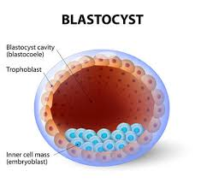
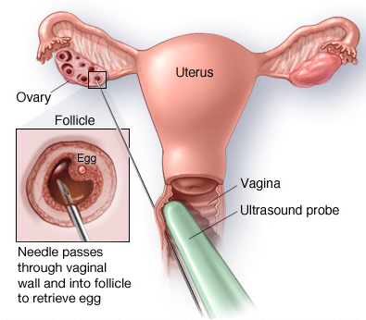
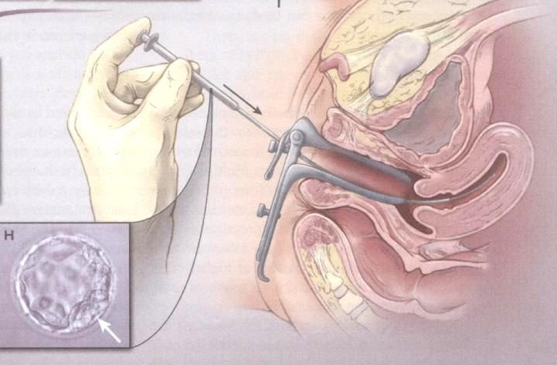
IVF
The basic steps of an IVF cycle are
  Ovarian stimulation
  Egg retrieval
  Insemination, fertilization, embryo culture
  Embryo transfer

Slide 6
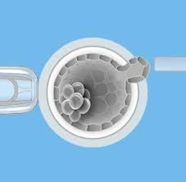

PGT - Requirements
In addition to IVF, PGT requires:
  Test set-up
  Embryo biopsy
  Genetic testing of biopsied cells (often requiring test set-up)
  Cryopreservation of embryos

Slide 7
PGT - Indications
PGT-M
  Single gene disorders
PGT-SR
  Balanced translocations
  Inversions
PGT-A
  Sex selection for genetic indications
  Maternal age
  Recurrent pregnancy loss
  Repetitive IVF failure
PGT-HLA
  When HLA typing is needed/desired

Slide 8
PGT – Test Set-up
Prior to starting IVF the lab that will be performing the testing will need to design a genetic test specific to the patient/couple’s situation
What do they need?
  Copies of genetic test results
  Blood/saliva/DNA samples from the couple and possibly other family members
  Time
    Test set typically takes several weeks

Slide 9
PGT-M
Current standard of practice is to use targeted haplotyping of closely linked or intragenic informative polymorphic markers (SNPs or STRs) with or without direct mutation detection
Often several weeks are required for test set-up

Slide 10
PGT-M - Considerations
  Typically the pathogenic variant(s) in the family needs to have been identified
  Often samples from family members with/carriers of the condition are requested
  Concerns about allele drop out
  Not all mutations are equal
    Some types of mutations are more difficult to detect directly with PGT (compared to pre/postnatal testing)
  PGT for mitochondrial conditions caused by mutations in mitochondrial DNA is not currently performed
Notes:
Point 2 Labs standardly use linkage analysis to increase accuracy
Additional family member samples allow linkage phase to be set with better certainty
Point 3 – Happens in a low but significant proportion of single cells – why linkage is important
Point 4 - Direct mutation analysis is not performed for triplet repeat disorders, large deletions, inversions
Linkage analysis is performed in these cases
Requires samples from other family members to set phase
Triplet Repeat Disorders
Do not test for repeat size
Only assess which copy of the allele has been inherited by the embryo
Point 5 - Mitochondrial mutation detection is complicated
Heteroplasmy
Cannot predict clinical outcome – these conditions are highly variable

Slide 11
PGT-M - New Complexities
WES/WGS adds new complexities
  WES/WGS is often used in cases where other testing has failed to determine an etiology for an individual’s condition
    Variants of uncertain significance
      Will PGT labs perform testing these variants?
    New genes
      Can PGT labs perform testing in genes that are fairly newly described?
      Do labs have markers for these regions?

Slide 12
PGT-A and PGT-SR
The development of technologies for single cell whole genome amplification (WGA) allows for analysis of all 24 chromosomes.
Metaphase CGH qPCR, aCGH, SNP arrays NGS
These methods have resulted in
  Improvement in implantation rates and live birth rates
  Decreased miscarriage rate
  Changed practice patterns to allow for elective single embryo transfer without sacrificing high success rates for patients

Slide 13
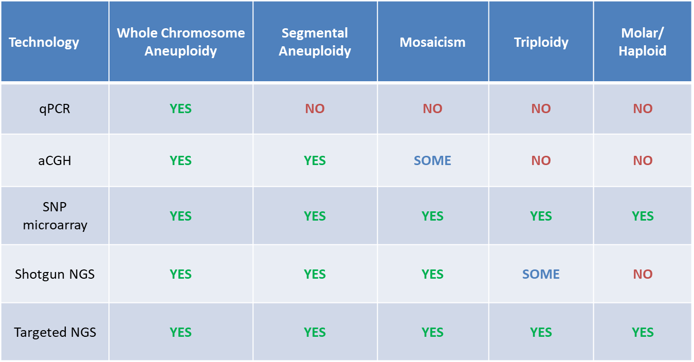
PGT-A/PGT-SR
Technology Comparison

Slide 14
PGT-A/PGT-SR - Possible Results
Normal
  No whole chromosome aneuploidy
  No segmental aneuploidy
    Limit of detection varies by lab
Abnormal
  Whole chromosome and/or segmental aneuploidy
Other results
  Failed amplification
  Mosaicism

Slide 15
PGT-A/PGT-SR - Considerations
Translocations/Inversions
  Arrays and NGS have made detecting unbalanced translocations/inversions easier
    Size does matter
  Cannot differentiate between the presence of no translocation/inversion (normal) and a balanced translocation/inversion
    Patients often believe that PGT provides this information
Microdeletions not readily detectable due to resolution of testing
No results or partial results
  7% of embryos due to degrading DNA or quality issues
Unable to rule out mosaicism
  Newer studies show ranges of mosaicism in embryos from 10-30%
Chance for no normal embryos
Age | Risk of Chrom Abnl
30 | 33%
31 | 34%
32 | 34%
33 | c36%
34 | 39%
35 | 41%
36 | 45%
37 | 50%
38 | 45%
39 | 54%
40 | 65%
41 | 75%
42+ | 81%

Slide 16
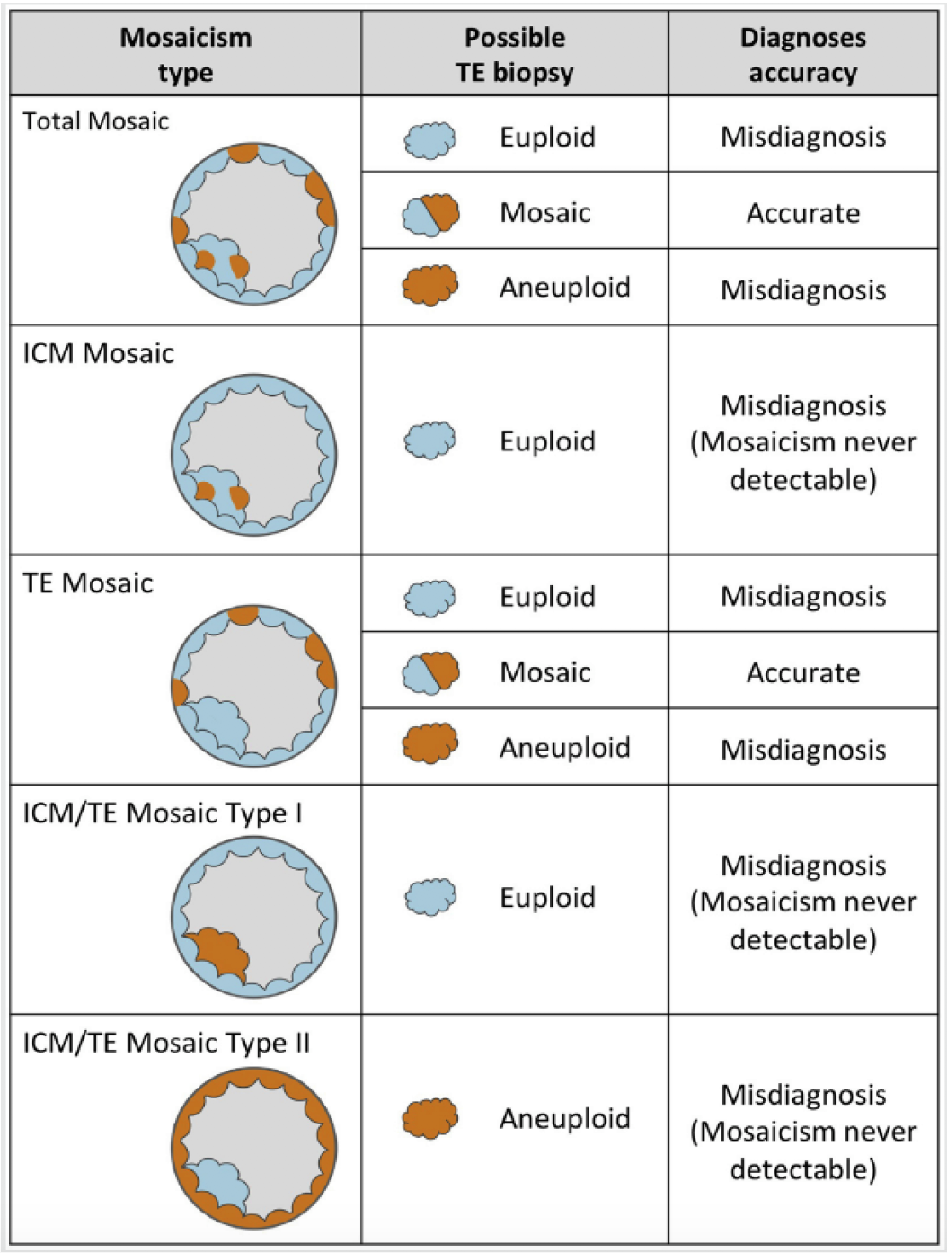
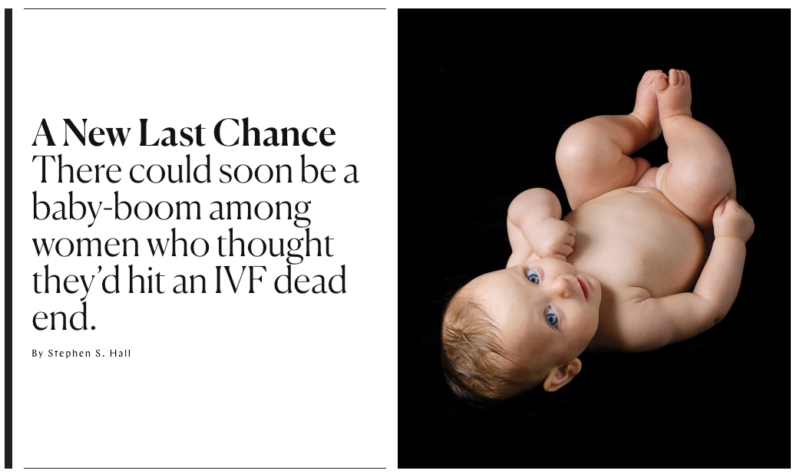
PGT-A/PGT-SR – New (but old) Complexities
Mosaicism
  Are we overcalling embryos?
  Should we consider transfer of some embryos with aneuploidy? When?

Slide 17
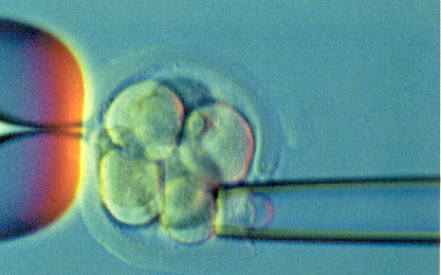
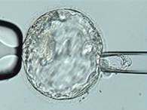
Mosaicism
Evolving and improving PGS technologies have now led to the ability to classify embryos as mosaic.
This has resulted from
  Use of aCGH and NGS
    Early estimates demonstrate mosaicism levels as low as 20% may be detected

Slide 18
Mosaicism
What is the clinical significance of mosaicism diagnosed by PGT-A?
  Self-correction
  Trophectoderm = inner cell mass?
  Distribution of abnormal cells
  Reduced implantation rate/miscarriage
  CPM risks
  Labs report mosaicism differently
There is no consensus about how data about mosaicism should be interpreted or used in clinical management
  Besser AG, Mounts EL. Counselling considerations for chromosomal mosaicism detected by preimplantation genetic screening. Reprod Biomed Online. 2017 Apr;34(4):369-374.
  Grati FR, Gallazzi G, Branca L, Maggi F, Simoni G, Yaron Y. An evidence-based scoring system for prioritizing mosaic aneuploid embryos following preimplantation genetic screening. Reprod Biomed Online. 2018 Apr;36(4):442-449.
What do we offer these patients when they get to our clinics?
Normal
<20%
Mosaic
21-79%
Abnormal
>80%
Vs.
Normal
<40%
Mosaic
41-59%
Abnormal
>60%

Slide 19
What’s Next?
Mitochondrial DNA quantification
  Unhealthy embryos may have a greater number of mitochondria due to stress
  Another marker of embryo quality?
Mitochondrial DNA transfer
  Allowed in UK, not currently allowed in US
Transfer of mosaic embryos (already here)
Whole exome sequencing of embryos (reported on a research basis)
Targeted genomic editing of embryos (reported on a research basis)

Slide 20
What do you need to know?
PGT can be performed for most single gene conditions and for many chromosome abnormalities
  Recommendation: Confirm with a PGT lab that testing can be performed in your patient’s situation
For single gene conditions, testing is typically performed using linkage analysis/haplotyping (direct mutation analysis used less commonly)
  Requires several weeks for test set up
  Typically samples from multiple family members are needed for test set up
  Recommendation: Contact a PGT lab to discuss what would be required in your patient’s situation

Slide 21
What do you need to know?
PGT does not replace prenatal or postnatal testing
Risk of embryo biopsy
Cost/Insurance
  Letters to insurance
  Grants/Scholarships
    http://www.resolve.org/family-building-options/making-treatment-affordable/infertility-treatment-grants-and-scholarships.html
    http://www.fertilethoughts.com/financing-your-infertility-treatments-grants

Slide 22
What do patients need to think about?
IVF with PGT does not guarantee a pregnancy.
Are they comfortable with the IVF and PGT process and the costs (financial, physical, psychological, etc…)?
What will they do with affected embryos? Are they comfortable with discarding embryos?
What will they do if they have no unaffected embryos?
What will they do with extra “normal” embryos?

Slide 23
Three Takeaways
PGT is an option that your patients should be made aware of
You will run into a patient who has had some type of PGT at some point in your practice
You don’t have to know all the ins and outs of PGT but you should know where to refer your patients for a more detailed discussion if they are interested in learning more about this option
  NSGC ART/Infertility SIG
  NSGC Find a Genetic Counselor Tool
    Search using the “PGD/Preconception” or ART/Preimplantation Genetic Disorders” options under types of specialization

Slide 24


