Slide 1
Maximizing Genetic Testing for Hereditary Cancer Using RNA Sequencing
Rachid Karam, MD PhD
Director, Ambry’s Translational Genomics Lab

Slide 2
Disclosures/ Conflict of Interest
I am a full time, salaried employee at Ambry Genetics.

Slide 3
Outline
• Introduction
• Summarize current uses of RNA-Seq
• Evaluate using RNA-Seq in genetic testing

Slide 4
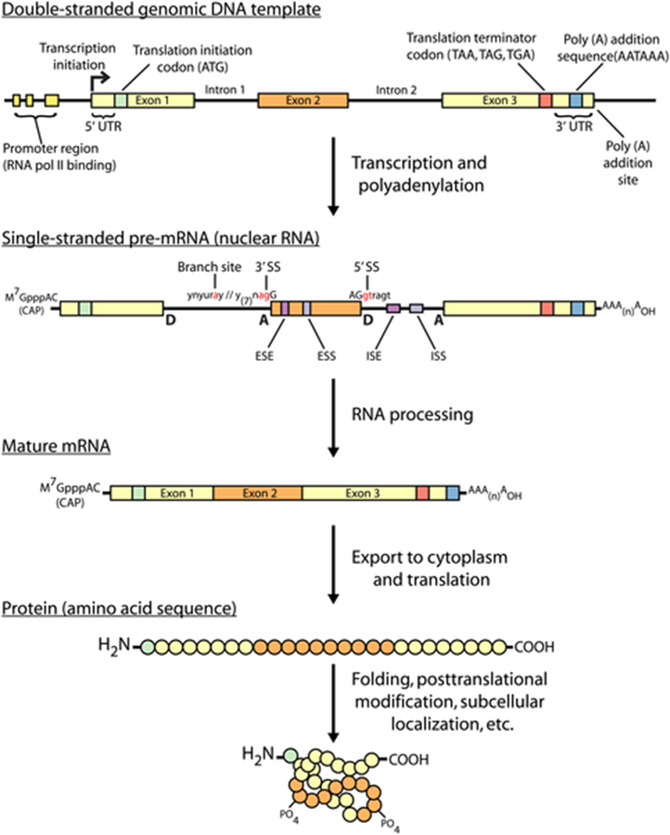
An overview of the central dogma of molecular biology
Griffith M, et al. (2015) PLoS Comput Biol 11(8): e1004393.

Slide 5
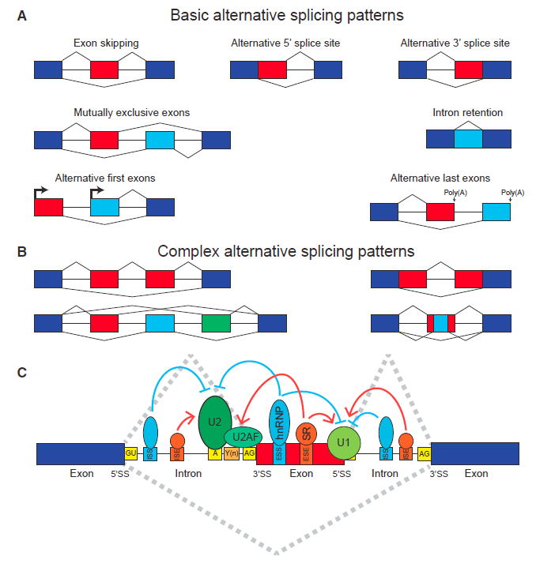
Splicing 101
Park E, et al. AJHG (2017)
Notes:
Figure 1. A Primer on Alternative
Splicing
(A and B) Basic (A) and complex (B)
patterns of alternative splicing. Darkblue
boxes represent constitutively spliced
exons. Red, light-blue, and green boxes
represent alternatively spliced exons.
(C) Alternative splicing is regulated by
an extensive protein-RNA interaction
network involving cis elements within
the pre-mRNA and trans-acting factors
that bind to these cis elements. The most
essential splicing signals within the premRNA
are the 50 splice site (50SS), 30 splice
site (30SS), branch site (A), and polypyrimidine
tract (Y(n)). The 50 and 30 splice sites
have highly conserved GU and AG dinucleotides
as the first and last two nucleotides
of the intron, respectively. The U1
snRNP complex recognizes the 50 splice
site, and the U2 snRNP complex recognizes
the branch site. The U2AF proteins recognize
the 30 splice site and polypyrimidine
tract. Exonic splicing enhancers (ESEs),
exonic splicing silencers (ESSs), intronic
splicing enhancers (ISEs), and intronic
splicing silencers (ISSs) are pre-mRNA cis
regulatory motifs that recruit various
RNA-binding proteins (e.g., SR and hnRNP
proteins) to regulate alternative splicing.

Slide 6
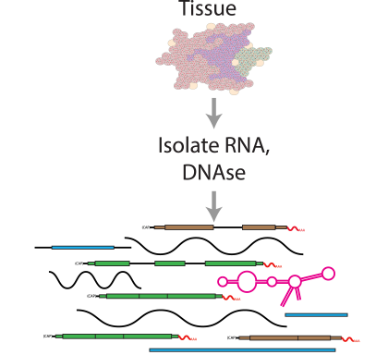
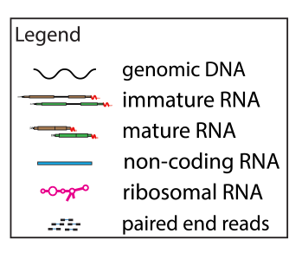
RNA-seq Strategies
Griffith M, et al. (2015) PLoS Comput Biol 11(8): e1004393.
Notes:
RNA-seq library construction protocols differ widely, and these differences have significant consequences for data interpretation and analysis. The figure above illustrates representative alignment results for either total RNA or one of three commonly used enrichment strategies at a hypothetical genomic locus with very highly expressed ribosomal RNA (pink), highly expressed protein coding (green), lowly expressed protein coding (brown) and lowly expressed noncoding RNA (blue) genes. (A) If total RNA is sequenced without enrichment, the vast majority of reads correspond to a small number of very highly expressed RNA species such as ribosomal RNAs (rRNAs). In humans, ~95%–98% of all RNA molecules may be rRNAs. A significant amount of genomic DNA (gDNA) and unprocessed heteronuclear RNA (hnRNA, also known as pre-mRNA) contamination may also remain after typical RNA isolation procedures. As a result, most reads will align to intronic, intergenic, and especially to ribosomal gene regions. Since analysis of these molecules is rarely the target of RNA-seq, various enrichment strategies are commonly employed. The amount of gDNA contamination in total RNA can be reduced, but not entirely eliminated, by use of a deoxyribonuclease (DNase) treatment. The amount of unprocessed RNA can be reduced, but not entirely eliminated, by employing an RNA isolation method that attempts to keep nuclei intact and removing these to enrich for mature mRNAs present in the cytoplasmic compartment. Additional strategies are discussed in S3 Table. * When sequencing total RNA, a complete representation of the transcriptome is theoretically present, but in practical terms, insufficient sequence reads are obtained to sufficiently sample all transcripts of all types, and some enrichment strategy is required to reduce extremely abundant rRNA species. (B) Selective rRNA reduction kits use oligonucleotides complementary to ribosomal sequences to specifically reduce the abundance of rRNAs while maintaining a broad representation of transcript species. Since the oligonucleotide probes used in these kits are only designed to bind to and deplete rRNA sequences, a significant amount of unprocessed RNA and gDNA contamination may remain. (C) Poly(A) selection and (D) cDNA capture methods specifically enrich for (primarily) mature polyadenylated RNA species or specific targets (e.g., all known transcript exons), respectively. Since poly(A) selection specifically targets RNAs that have been polyadenylated—a modification that happens at the end of the transcription process—poly(A) selection results in an enrichment for mature, completely processed RNAs. Poly(A) selection and cDNA capture methods sacrifice some transcriptome representation for increased signal to noise for transcripts of greater interest. Poly(A) methods will fail to represent most noncoding and other nonpolyadenylated RNAs. Capture methods on the other hand will under-represent any loci not specifically included in the capture design. For example, in this case the brown gene was not included in the design, and therefore, expression of this gene would be underestimated. Each of the methods depicted here has advantages and disadvantages (S3 Table and S7 Table). Furthermore, the relative amounts of each class of RNA depicted in each panel are hypothetical examples meant to demonstrate the goals and principles of each enrichment strategy and should not be interpreted quantitatively.

Slide 7
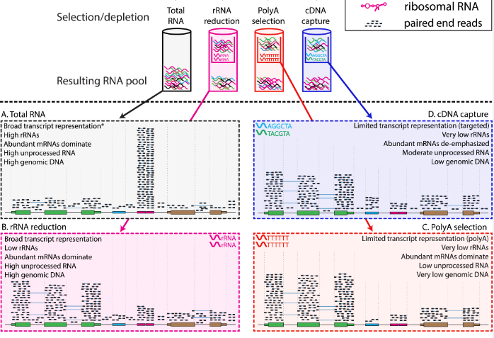
RNA-seq Strategies
Griffith M, et al. (2015) PLoS Comput Biol 11(8): e1004393.
Notes:
RNA-seq library construction protocols differ widely, and these differences have significant consequences for data interpretation and analysis. The figure above illustrates representative alignment results for either total RNA or one of three commonly used enrichment strategies at a hypothetical genomic locus with very highly expressed ribosomal RNA (pink), highly expressed protein coding (green), lowly expressed protein coding (brown) and lowly expressed noncoding RNA (blue) genes. (A) If total RNA is sequenced without enrichment, the vast majority of reads correspond to a small number of very highly expressed RNA species such as ribosomal RNAs (rRNAs). In humans, ~95%–98% of all RNA molecules may be rRNAs. A significant amount of genomic DNA (gDNA) and unprocessed heteronuclear RNA (hnRNA, also known as pre-mRNA) contamination may also remain after typical RNA isolation procedures. As a result, most reads will align to intronic, intergenic, and especially to ribosomal gene regions. Since analysis of these molecules is rarely the target of RNA-seq, various enrichment strategies are commonly employed. The amount of gDNA contamination in total RNA can be reduced, but not entirely eliminated, by use of a deoxyribonuclease (DNase) treatment. The amount of unprocessed RNA can be reduced, but not entirely eliminated, by employing an RNA isolation method that attempts to keep nuclei intact and removing these to enrich for mature mRNAs present in the cytoplasmic compartment. Additional strategies are discussed in S3 Table. * When sequencing total RNA, a complete representation of the transcriptome is theoretically present, but in practical terms, insufficient sequence reads are obtained to sufficiently sample all transcripts of all types, and some enrichment strategy is required to reduce extremely abundant rRNA species. (B) Selective rRNA reduction kits use oligonucleotides complementary to ribosomal sequences to specifically reduce the abundance of rRNAs while maintaining a broad representation of transcript species. Since the oligonucleotide probes used in these kits are only designed to bind to and deplete rRNA sequences, a significant amount of unprocessed RNA and gDNA contamination may remain. (C) Poly(A) selection and (D) cDNA capture methods specifically enrich for (primarily) mature polyadenylated RNA species or specific targets (e.g., all known transcript exons), respectively. Since poly(A) selection specifically targets RNAs that have been polyadenylated—a modification that happens at the end of the transcription process—poly(A) selection results in an enrichment for mature, completely processed RNAs. Poly(A) selection and cDNA capture methods sacrifice some transcriptome representation for increased signal to noise for transcripts of greater interest. Poly(A) methods will fail to represent most noncoding and other nonpolyadenylated RNAs. Capture methods on the other hand will under-represent any loci not specifically included in the capture design. For example, in this case the brown gene was not included in the design, and therefore, expression of this gene would be underestimated. Each of the methods depicted here has advantages and disadvantages (S3 Table and S7 Table). Furthermore, the relative amounts of each class of RNA depicted in each panel are hypothetical examples meant to demonstrate the goals and principles of each enrichment strategy and should not be interpreted quantitatively.

Slide 8
RNA-Seq Utility in Disease
Transcript discovery & genome annotation
Studying mechanisms of gene regulation & disease
Differential gene expression analysis [DEG]
Allele-specific expression [ASE] analysis
Variant discovery: deep intronic, fusions, duplications
Alternative Splicing analysis

Slide 9
RNA-seq
Alternative Splicing analysis:
Variant Classification

Slide 10
Variant Classification 101

Slide 11
RNA Eligible Genes – VUS Distribution by Type
N=307,812 patients; 51,828 with a VUS

Slide 12
RNA Eligible Genes VLP Distribution by Type
N=307,812 Patients Tested; 3,020 with VLP

Slide 13
RNA-seq (Splicing Analysis): CloneSeq
Farber-Katz, S. et al. 2018

Slide 14
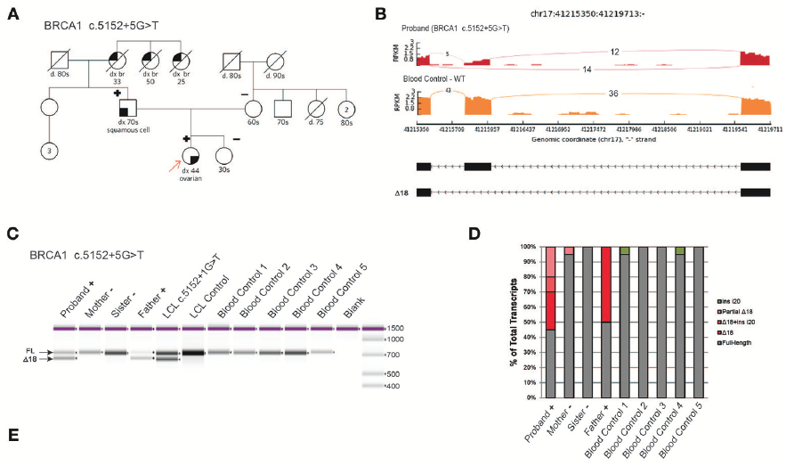
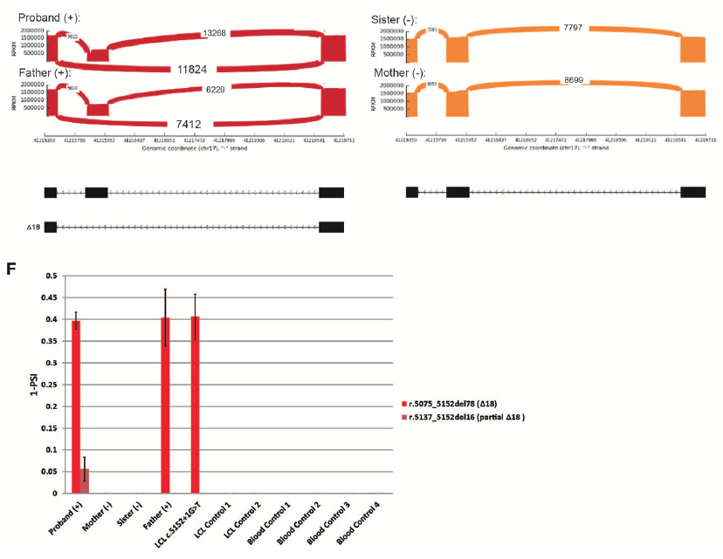
BRCA1 c.5152+5G>T VUS to VLP
Farber-Katz et al. 2018

Slide 15
RNA Testing Improves the Classification of Germline Sequence Variants

Slide 16
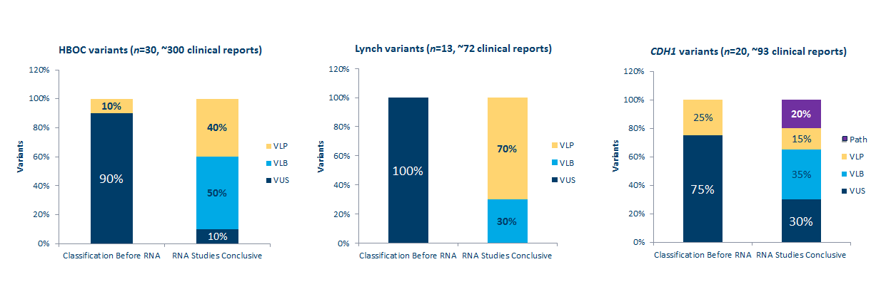
RNA Testing Improves the Classification of Germline Sequence Variants

Slide 17
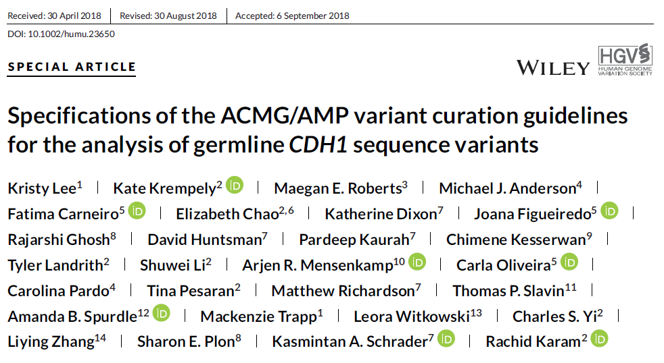

Slide 18
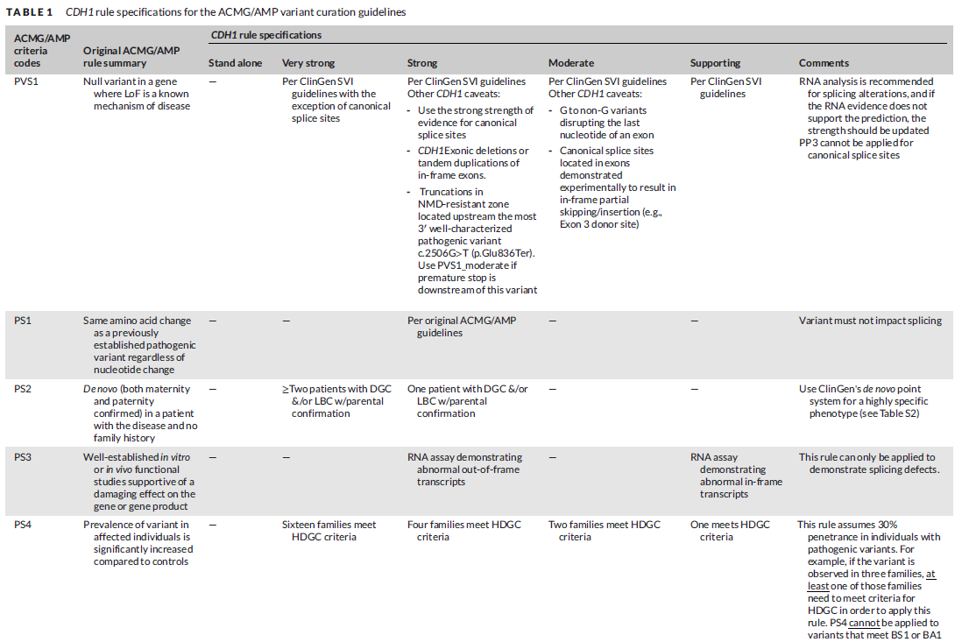

Slide 19
CDH1 c.1712-2A>C: VLP?

Slide 20
CDH1 c.1712-2A>C (r.1712_1720del9): VUS

Slide 21
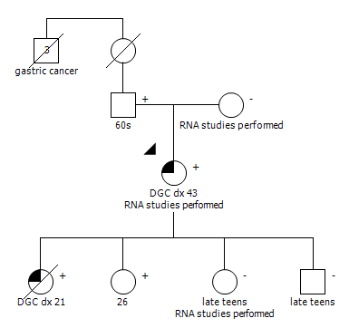
CDH1 p.T568R c.1703C>G: VUS>VLP

Slide 22
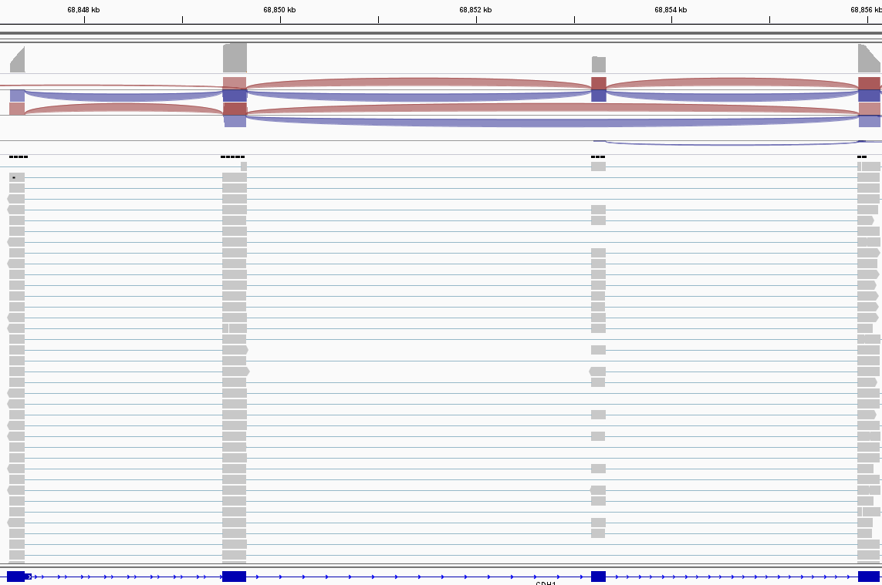
CDH1 c.1703C>G (r.1566_1711del146): VUS>VLP

Slide 23
RNA Testing Improves the Classification of Germline Sequence Variants

Slide 24
RNA-seq
Variant Discovery:
Deep Intronic Variants

Slide 25
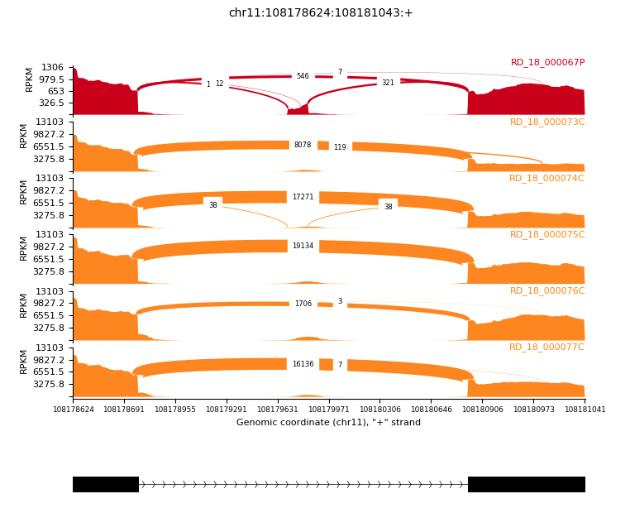
Deep Intronic Case Example: ATM c.5763-1050A>G (r.5762+985_5763-1055ins137)

Slide 26
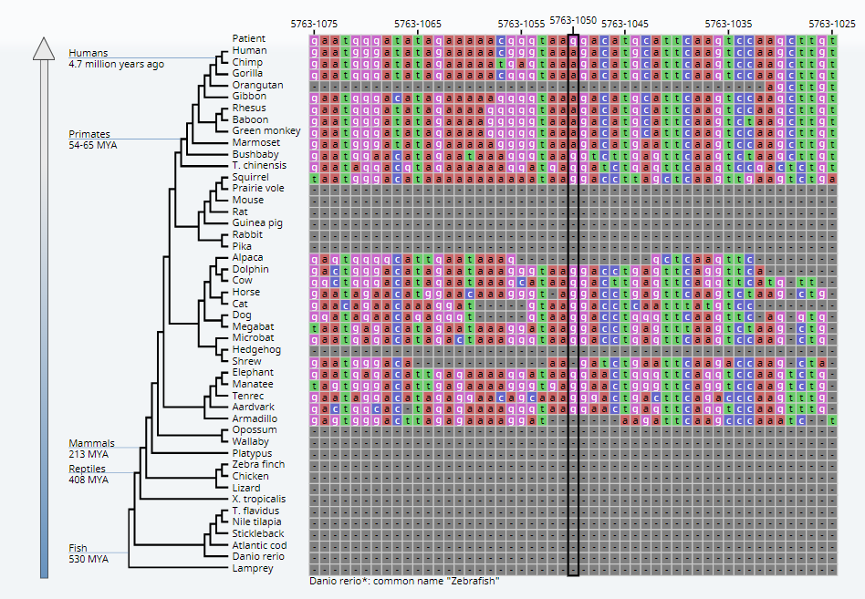
ATM c.5763-1050A>G (r.5762+985_5763-1055ins137)

Slide 27
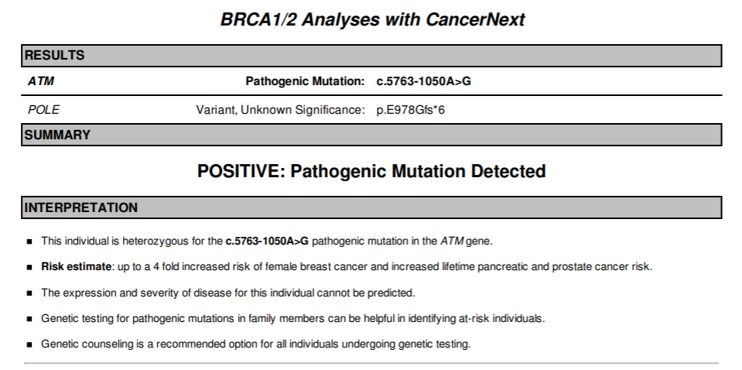
Final Report: ATM c.5763-1050A>G

Slide 28
RNA-seq
Variant Discovery:
Tandem Duplications

Slide 30
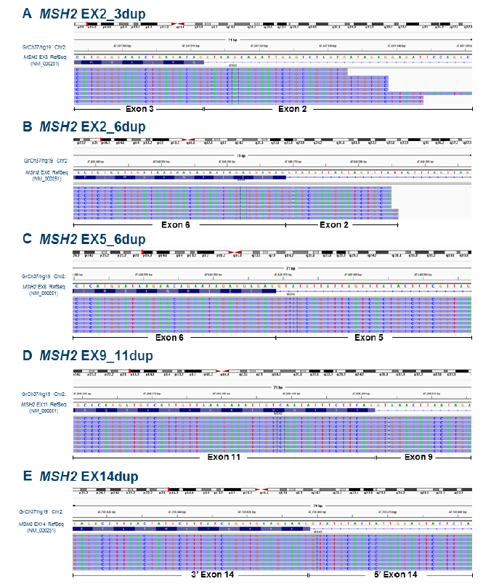
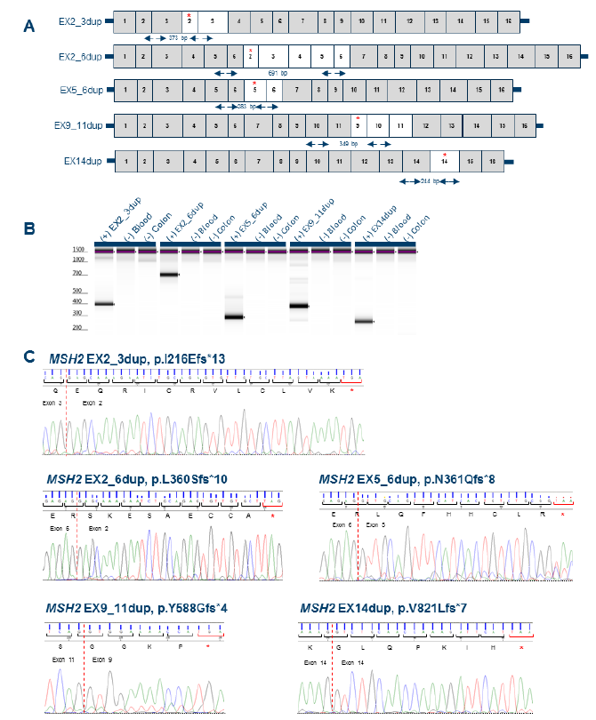

Slide 31
Summary
RNA-Seq is a Versatile Technique that Encompasses Different Approaches
RNA Testing Improves the Classification of Germline Sequence Variants
RNA-Seq Increases the Positive Yield of Genetic Testing

Slide 32
Thank you!

