Slide 1
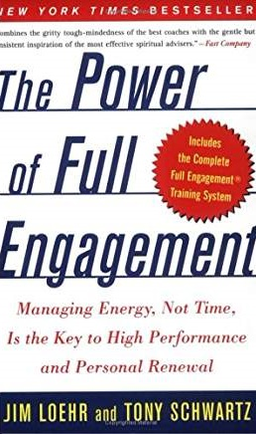
Katie Bergstrom, MS, CGC
Baylor College of Medicine
Pediatrics – Hematology/Oncology

Slide 2
Increasing patient load
Administrative tasks
Lack of support
Poor professional relationships
Extra responsibilities
Notes:
Studies show GCs are at HIGH RISK for burnout
Contributors:
Increasing patient load
Administrative tasks
Lack of support
Poor professional relationships
Extra responsibilities (teaching, research, etc.)
I feel like most of us can relate to something on this list – or the look on my face. But let’s do a quick test (privately, this is a challenge by choice). On your paper, answer the following on a scale of 1-10:
How excited are you to get to work in the morning?
How much do you enjoy what you do for its own sake, rather than for what it gets you?
How accountable do you hold yourself to a deeply held set of values?
If you scored 27 or better, what we’re talking about today may not apply to you right now. For those of us under 27, I think you might learn something from reading this book.

Slide 3
Energy, not time, is our most precious resource
Notes:
Main tenant of the book. Instead of time management, we should focus on managing our energy. Time management is depressing – time is finite! Instead, energy can be expanded and renewed. Life should be measured as a series of sprints with ritualistic downtime to recharge.
Energy is infectious – negative energy feeds on itself and leaders have a disproportionate impact on the energy of others. Matters not only for yourself, but for those love ones, colleagues, and patients around you.

Slide 4
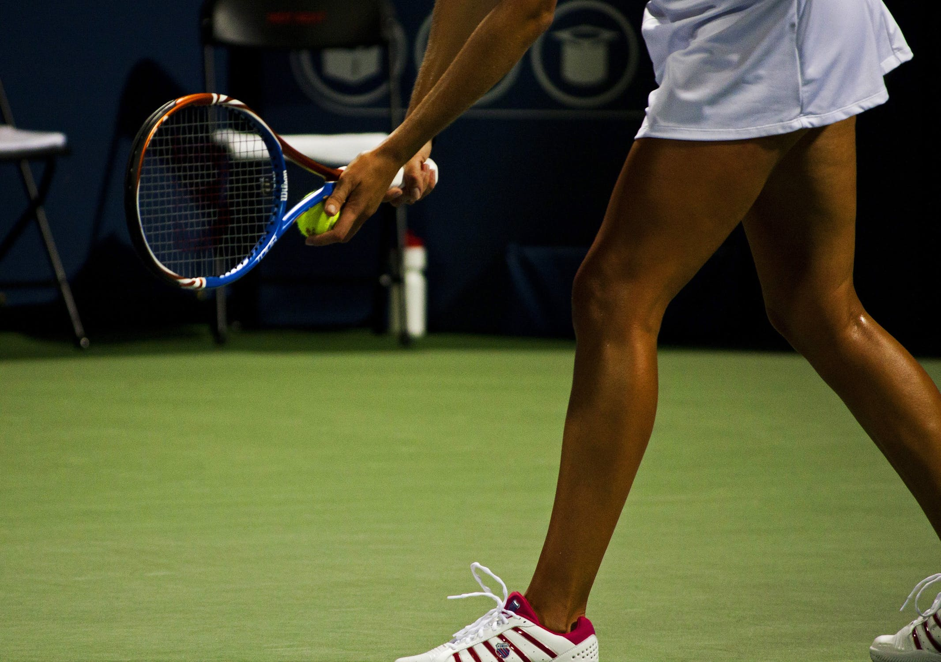
Notes:
What do the authors know about this? They developed theories and process from years of working with professional athletes. The athletes demanded measurable results (data). Might that be attractive to genetic counselors too? The principles the authors develop can apply to us.
The most successful athletes had small energy renewing rituals. Tennis player who spins the racket or walks behind the line between serves. Their heart rates lower 20 bpm during this renewal over the less successful athletes without the renewal rituals.

Slide 5
Four sources of energy
Physical
Mental
Spiritual
Emotional
Notes:
Physical energy measured in quantity (low to high)
Emotional energy measured in quality (negative to positive)
Mental capacity is defined by focus of energy
Spiritual capacity is defined by the force of energy
Most of us are undertrained physically and spiritually, and overtrained mentally and emotionally.

Slide 6
Dynamics of Energy
HIGH
Angry
Fearful
Anxious
Defensive
Resentful
Invigorated
Confident
Challenged
Joyful
Connected
NEGATIVE
POSITIVE
Depressed
Exhausted
Burned Out
Hopeless
Defeated
Relaxed
Mellow
Peaceful
Tranquil
Serene
LOW
Notes:
The negative energy affects performance, the more positive energy is efficient
The goal is to have cycles of full engagement and strategic disengagement to be most efficient

Slide 7
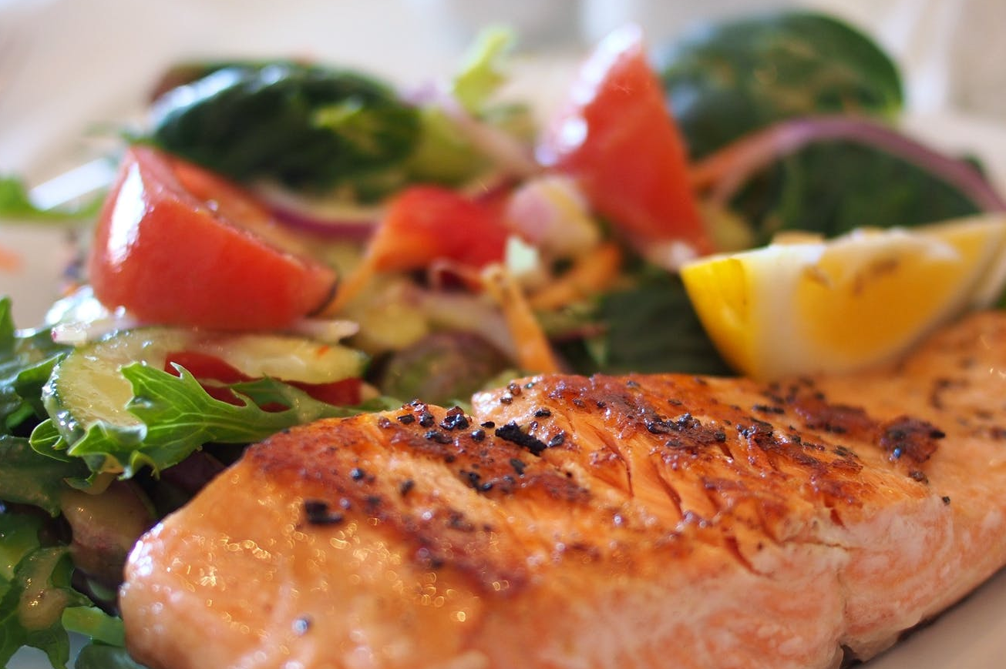
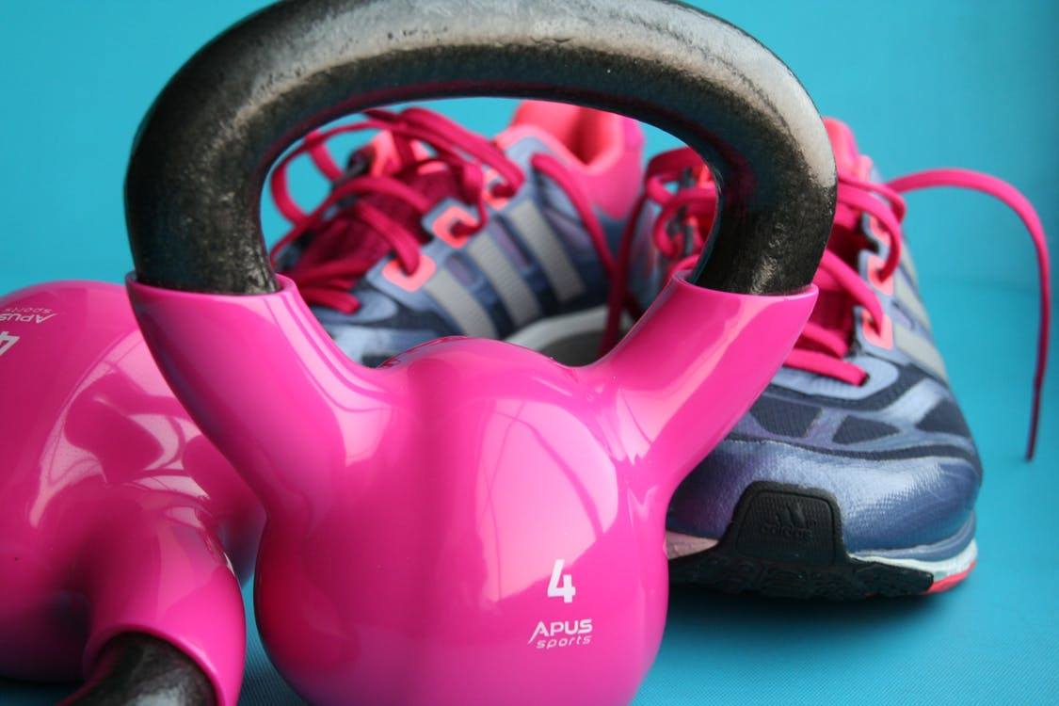
Physical

Slide 8
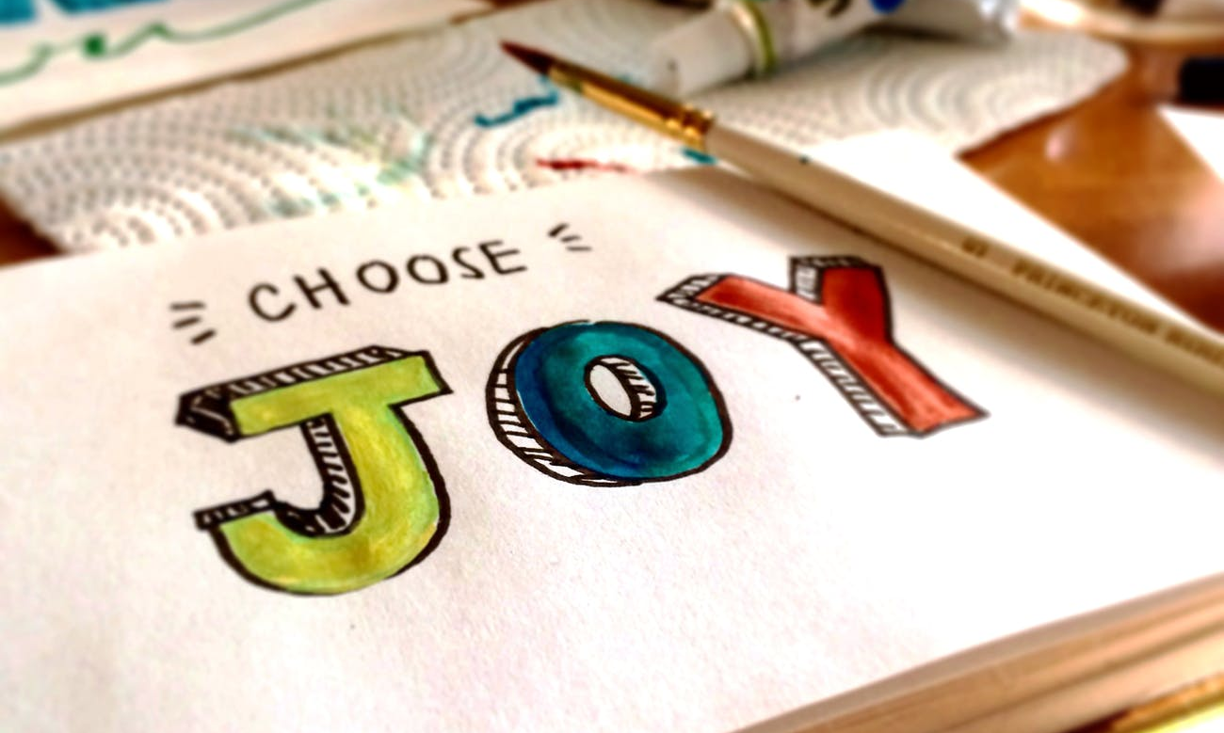
Emotional
Notes:
Key emotional muscles are: self-confidence, self-control, interpersonal effectiveness, and empathy
Negative emotions are essential for survival, but ultimately drain you emotionally
Summon positive emotions during times of stress

Slide 9
Mental
Notes:
Mental preparation, visualization, positive self-talk, effective time management to build in moments for creativity. Changing focus allows different parts of the brain to activate.
Where do you get your best ideas? Not at work! In the shower

Slide 10
Spiritual
Notes:
Spiritual energy is that derived from our connection to deeply held values and a purpose beyond self-interest
Spiritual energy expenditure and renewal are deeply intertwined – the key muscles are passion, commitment, integrity, and honesty

Slide 11
Become Fully Engaged
Determine your values and purpose
Perform a self-energy audit
Identify muscles to train
Develop your own rituals
Notes:
Harness your own sources of energy for high efficiency and performance between cycles of full engagement and strategic disengagement
How do your behaviors and habits match your values?

Slide 12
Example

Slide 13
Example
Targeted muscle: Focus/Mental Preparation
Value Driving Change: Responsibility
Expected Consequence: Higher productivity
Positive Energy Ritual Supporting Change | Launch Date
Checking email before work | 02/18/2019
Disable email notification alerts | 02/18/2019

Slide 14
Read the Book
Notes:
Harness your own sources of energy for high efficiency and performance between cycles of full engagement and strategic disengagement
How do your behaviors and habits match your values?

Slide 15
References
Johnstone B et al. 2016. The Relationship Between Burnout and Occupational Stress in Genetic Counselors. Journal of Genetic Counseling 25: 731-741
Johnstone B et al. 2016. The Relationship Between Burnout and Occupational Stress in Genetic Counselors. Journal of Genetic Counseling 25: 731-741.

